Slide 1
RUNGTA COLLEGE OF DENTAL SCIENCES & RESEARCH
TITLE OF THE TOPIC: TRAUMATIC INJURIES
DEPARTMENT OF CONSERVATIVE DENTISTRY AND ENDODONTICS

Slide 2
Specific learning Objectives
At the end of this presentation the learner is expected to know
Core areas* H | Domain ** | Category #
Classification of fractures,etiology of fractures complicated and uncomplicated crown fractures, | Cognitive | Must know
Clinical examination of tooth fracture, Avulsion | Psychomotor | Nice to know
Luxation injuries, root fracture | Affective | Desire to know
*Subtopic of importance
** Cognitive, Psychomotor or Affective
# Must know , Nice to know & Desire to know

Slide 3
Table of Content
Introduction
Classification
Etiology and causes
Clinical examination
Enamel fractures
Uncomplicated crown fracture
complicated crown fracture
Crown root fracture
Root fracture
Luxation injuries
Avulsion
conclusion

Slide 4
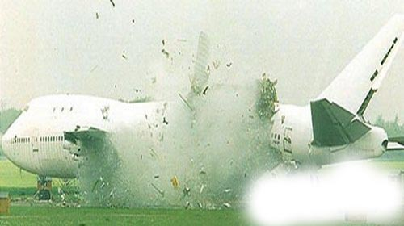
TRAUMATIC INJURIES TO TEETH
TRAUMATIC INJURIES TO TEETH

Slide 5
CONTENTS
Introduction
Classification
Etiology and causes
Clinical examination
Enamel fractures
Uncomplicated crown fracture
complicated crown fracture
Crown root fracture
Root fracture
Luxation injuries
Avulsion
conclusion

Slide 6
Introduction
Traumatic dental injuries are everyday occurrences and their prevalence has been continuously rising.
Trauma has been one of the main etiological factor for numerous restorative and endodontic procedures.
A thorough knowledge of various types of traumatic injuries is mandatory to treat these cases successfully.

Slide 7
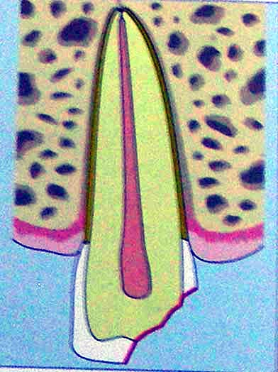
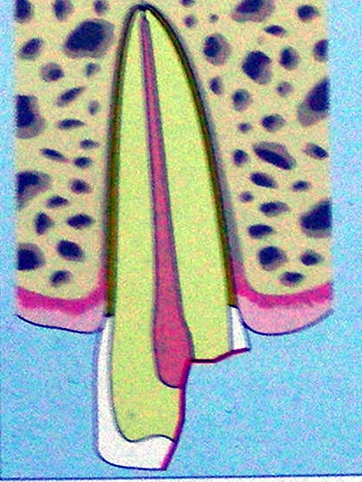
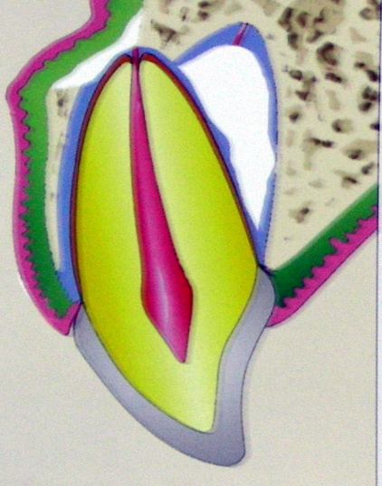
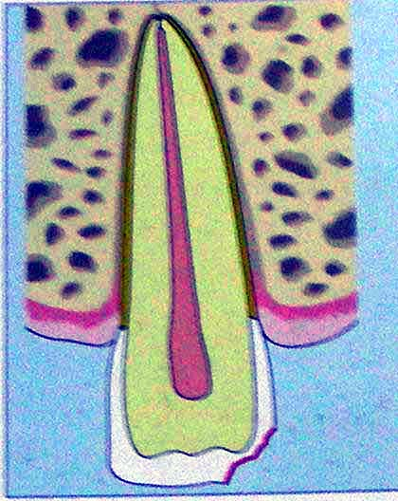
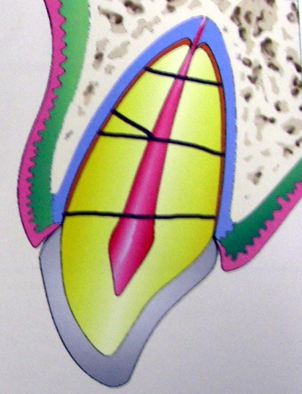
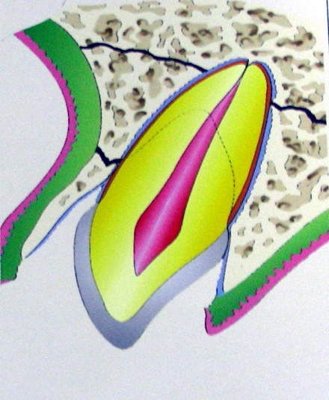
CLASSIFICATIONS
Ellis classification
class 1
class 2
class 3
class 4
class 5
Class 6

Slide 8
Ellis And Daveys Classification
Class I – simple crown fracture with plain enamel involvement
Class II – extended crown fracture with noticeable dentinal involvement, without pulp exposure
Class III - extended crown fracture with noticeable dentinal involvement, with pulp exposure
Class IV – teeth that lost vitality, with or without loss of crown tissues
Class V – traumatically avulsed teeth
Class VI – crown fracture with or without loss of crown tissues
Class VII - tooth luxation without crown or root fracture
Class VIII – cervical crown fracture
Class IX - traumatic injuries on primary teeth

Slide 9
WHO classification (1978)
873.60 – crown fracture involving only enamel
873.61 – crown fracture involving enamel and dentin without pulp exposure
873.62 – crown fracture involving enamel and dentin with pulp exposure
873.63 – root fracture
873.64 – crown root fracture
873.66 – tooth luxation
873.67 – tooth intrusion or extrusion
873.68 – tooth avulsion
873.69 – other injuries ( soft tissue injuries )

Slide 10
Andreasen modification of WHO classification
873.64 – complicated and uncomplicated crown root fracture
873.66 – concussion
Subluxation
Luxation injuries with alveolar fractures

Slide 11
WHO classification (1995)
S.02.5 - Fracture Of Tooth
S.02.50 - Fracture of enamel only + enamel infraction
S.02.51 - Fracture of crown of tooth without
pulpal involvement
S.02.52 - Fracture of crown of tooth with
pulpal involvement
S.02.53 - fracture of root of tooth
S.02.54 - Fracture of crown with root of tooth,
with or without pulpal involvement
S.02.57 - multiple fractures of tooth

Slide 12
Andreasen classification
Injuries to teeth
Crown infraction and uncomplicated fracture without involvement of dentin
Uncomplicated crown fracture with involvement of dentin
Complicated crown fracture
Uncomplicated crown root fracture
Complicated crown root fracture
Root fracture

Slide 13
Injuries to periodontal tissues
Concussion
Subluxation
Intrusive luxation
Extrusive luxation
lateral luxation
Exarticulation

Slide 14
Garcia Godoys classification
Class 0 – enamel crack
Class 1 – enamel fracture
Class 2 – enamel- dentin fracture without pulp exposure
Class 3 – enamel-dentin fracture with pulp exposure
Class 4 – enamel-dentin-cementum fracture without pulp exposure
Class 5 – enamel-dentin-cementum fracture with pulp exposure
Class 6 – root fracture
Class 7 – concussion
Class 8 – luxation ( loosening )
Class 9 – lateral displacement
Class 10 – intrusion
Class 11 – extrusion
Class 12 – avulsion

Slide 15
Pulver classification
Class I
Division I – no external fracture, no displacement
Division II – displacement but no fracture
Division III – fracture of enamel only, no displacement
Division IV – displacement and fracture of enamel only
Class II
Division I – fracture of enamel and dentin only, no displacement
Division II - displacement and fracture of enamel and dentin only

Slide 16
Class III
Division I – fracture (with exposure of pulp), no displacement
Division II – displacement and fracture (with exposure of pulp)
Class IV
Division I – fracture of root
Class V
Division I – intrusion
Division II – partial avulsion
Division III –complete avulsion

Slide 17
Heithersay and Morile classification (sub gingival fractures)
Class 1 – fracture line does not extend below the level of attached gingiva
Class 2 – fracture line extends below the level of attached gingiva but above the crest of alveolar bone
Class 3 – fracture line extend below the level of crest of alveolar bone
Class 4 – fracture line is within the coronal third of root but below the level of crest of alveolar bone

Slide 18
Ingle classification
Soft tissues
Lacerations
Contusions
Abrasions
Tooth fractures
Enamel fracture
Crown fracture – uncomplicated
Crown fracture – complicated
Crown root fracture
Root fracture
Luxation injuries
Tooth concussion
Subluxation
Intrusive luxation
Lateral luxation
Extrusive luxation
Avulsion
Facial skeletal injuries
Alveolar process
Body of mandible
TMJ

Slide 19
Causes and incidence
Accidental falls
RTA
Acts of violence
Sports
8 to 12 years – most accident prone
Maxillary cental incisors, lateral incisors and
then mandibular incisors
Most common dental trauma – enamel fracture or
uncomplicated crown fracture

Slide 20
Clinical examination
Soft tissues
- adjacent to fractured teeth should be carefully examined and palpated
Facial bones
Teeth
1. Fracture
2. Mobility
3. Displacement
4. Injury to periodontal tissues

Slide 21
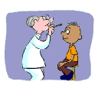
5. PULPAL TRAUMA
evaluated both initially and at various times following the trauma
Pulp stunning
Pulp test unpredictable in trauma – why???
(Pillegi et al,EDT’96)
GO FOR
a. Thermal test (cold test) – young teeth
b. EPT – older patients

Slide 22
LDF – promising
practical problems
PULSE OXIMETRY
measuring vascular health by evaluating
oxygen saturation
highly effective – recently traumatised teeth
(Velayutham et al’07)

Slide 23
Prognosis of pulp after different levels of fracture
LEVEL OF FRACTURE | PROGNOSIS OF PULP
Enamel infraction | 97 – 100% survival
Enamel fracture | 99-100% survival
Enamel – dentin fracture uncomplicated | 75-98% survival 0.2%-0.5% obliteration
Enamel – dentin fracture complicated | Direct pulp capping:72-81% Vital amputation 94 -100%
All crown root fractures | Worse than crown fractures, no reports available
(Olsburg et al’01)

Slide 24
Prognosis of pulp after luxation injuries
Type of luxation injury | Pulp death
concussion | 4%
sub-luxation | 12%
lateral luxation | 77%
extrusive luxation | 55 – 98%
intrusive luxation | 100%
Barnett et al ‘02

Slide 25
Radiographic examination
- embedded fragments in soft tissues
- dislocations
- root and jaw fractures
- resorptive and calcific changes

Slide 26
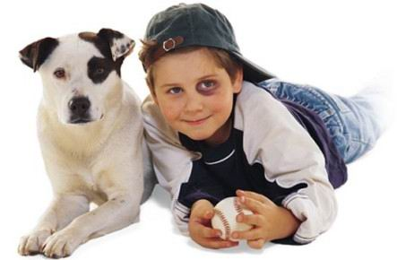
Soft tissue injury

Slide 27
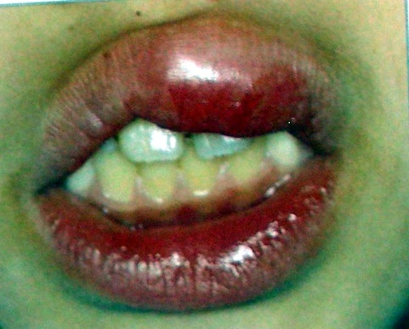
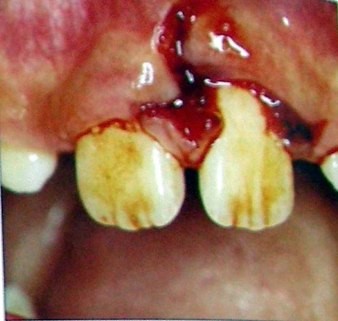
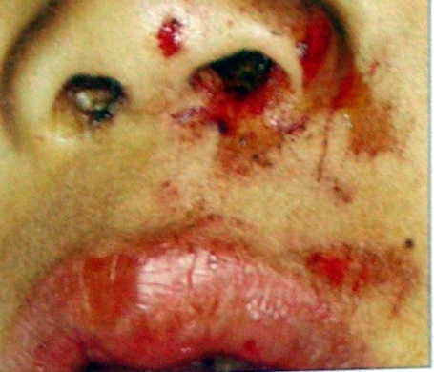
Soft tissue injuries
Laceration
Abrasion
Contusion
control bleeding, repositioning displaced tissues and suturing

Slide 28
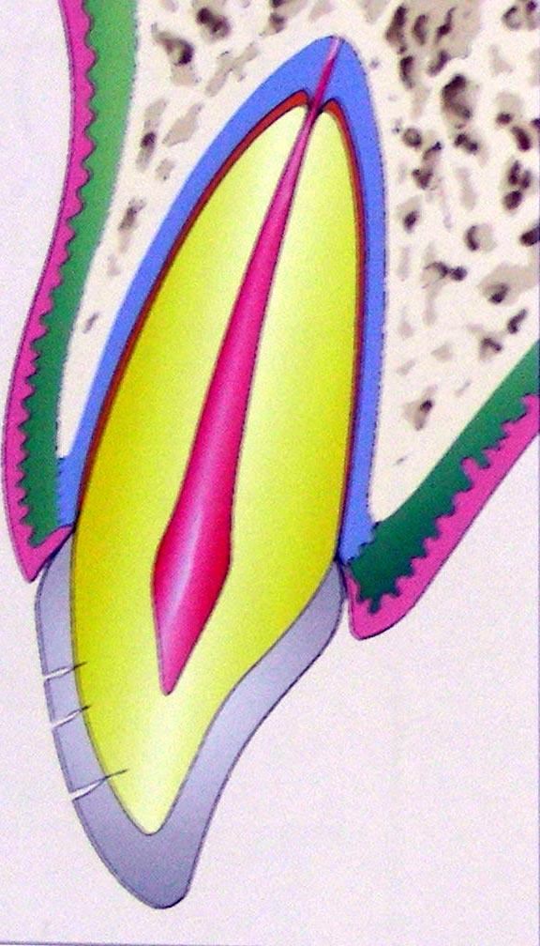
Enamel fracture
Chips and cracks confined to enamel
Enamel infractions – transillumination, indirect light or disclosing dyes
Cracks – no treatment
Follow up

Slide 29
Crown fractures (uncomplicated)
Outcome – formation of irritation dentin or pulp necrosis
Uncomplicated
Crown
fracture
management
reattachment
LCR

Slide 30
Composite Build Up Restores About 100% Strength Recovery
Reattachment of fractured fragment – restores around 50% to 60% of original strength (worthington et al ’99)
GO IN FOR REATTACHMENT WHENEVER POSSIBLE !!!

Slide 31
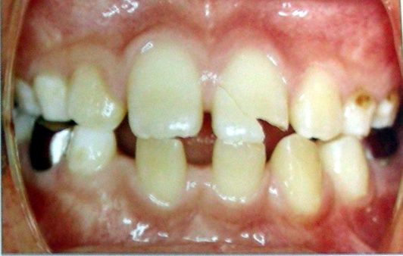
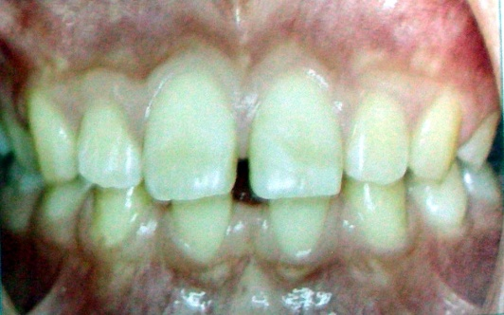
Methods of reattachment
A. using circumferential bevel before reattaching
B. using a V shaped notch
C. placing a internal groove

Slide 32
D. placing a chamfer at the fracture line after reattaching
E. superficial over contour over the fracture line
F. simple reattachment

Slide 33
Fracture strength of different reattachment techniques
Superficial over contour, placing a internal groove provided fracture strength as high as sound teeth (Reis & others ‘01)
Influence of materials used in reattachment on fracture strength
Different material combinations used to bond tooth fragments to remaining crown were found to have no influence on fracture strength after bonding
(Reis, Kraul et al ’02)

Slide 34
Teaching Materials
Endodontic practices - Grossman
Pathways of pulp – Cohen
Textbook of Endodontics – Nisha Garg
Endodontics - Ingle

Slide 35
TAKE HOME MESSEGE/ FOR THE TOPIC COVERED (SUMMARY)
Various factors influence the outcome of teeth that had undergone trauma.
Correct diagnosis, quality and timeliness of initial and long term treatment can improve the prognosis of the traumatized teeth.

Slide 36
Question & Answer Session
Classification of traumatic injuries?
Clinical examination of traumatic injuries

Slide 37
REFERENCES
Endodontic practices - Grossman
Pathways of pulp – Cohen
Textbook of Endodontics – Nisha Garg
Endodontics - Ingle

Slide 38
THANK YOU

